Slide 1
Executive summary NYC Taxi Limousine Commission
Preliminary Data Analysis Report

Slide 2
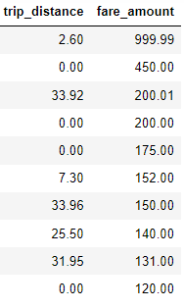
New York City TLC Project Preliminary Report
Executive summary report
Commission Prepared by Automatidata
In this report a initial exploration of the data o f the NYC Taxi Limousine Commission was done to inform about key variables with the use of descriptive statistics. These results will help to create further more detailed reports with key insights.
Find any unusual values.
Find potential correlations between two variables
Consider which variables are most suitable to build a predictive model
Identify components of the data that will provide key insights.
Lay down the groundwork for further research with other analysis methods such as exploratory analysis, modeling and visualization.
The dataset does have variables than are useful to help build a data model
There are some short distance trips that are expensive because include other charges. Please refer to the image attached.
Image Alt-Text Here
Image Alt-Text Here
Perform EDA
Perform data cleaning and data analysis to find outliers or any anomalies
Build and run a regression model

